Slide 1
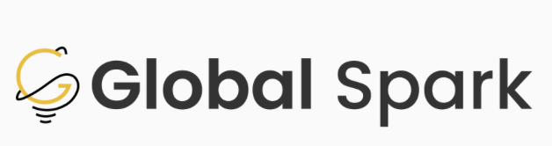
Each hackathon project will be built around a specific theme - a focus area that outlines the kind of problems you’ll be solving and the impact your solution aims to create. Themes are designed to help guide your creativity, give structure to your ideas, and ensure your project is aligned with the overall goals of the event.
Your final project will be evaluated by a panel of judges who are experts in that theme’s domain. A strong alignment between your project and your chosen theme can significantly boost your score, as it shows you’ve understood the problem space, used relevant insights, and tailored your solution to the needs and opportunities in that area.
In short:
Themes help you focus your ideas.
Judges are specialists in the theme you choose.
The closer your solution matches the theme’s goals, the better your chances of impressing the panel.

Slide 2
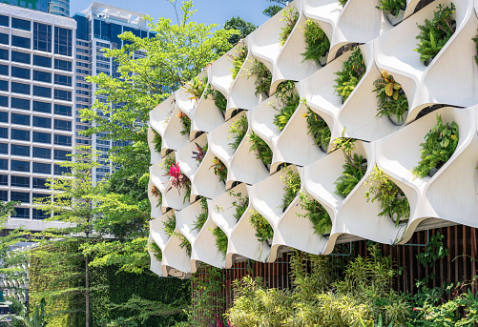
Sustainable Infrastructure
Advancing proactive and reactive sustainable solutions to mitigate key environmental challenges with urban and rural infrastructure

Slide 3
Table of Contents
1
Executive Summary
Overview
Relevant SDGs
Subthemes
Examples
… 04
… 05
… 06
… 08
… 18
2
3
4
5

Slide 4
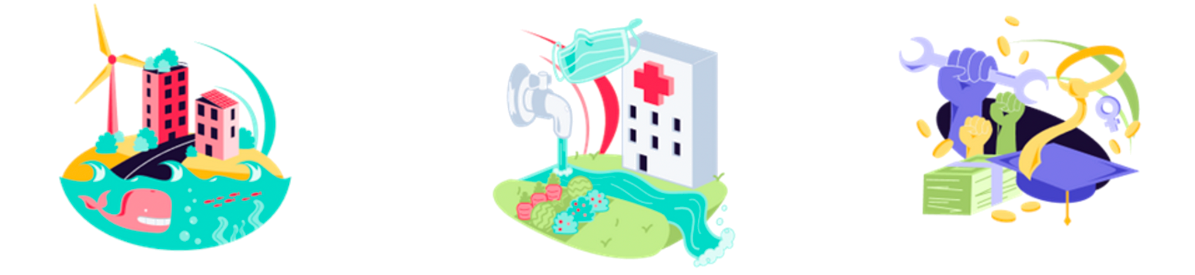
Executive Summary
Develop and deploy broad-based solutions not only to limit and mitigate future climate change, but to address challenges caused by changes in climate that have already arrived.
Key UN SDGs: SDG 7: Affordable and Clean Energy, SDG 9 - Industry, Innovation, and Infrastructure, SDG 11 - Sustainable Cities and Communities, SDG 12 - Responsible Consumption and Production, SDG 13 - Climate Action, SDG 14 - Life Below Water, SDG 15 - Life on Land
Subthemes:
Clean Energy
Ecosystem Conservation
Urban Resilience
Smart Cities
Transportation & Infrastructure
Sustainable Consumption
Climate Change
Pollution: Carbon Capture & Sequestration
Biodiversity Governance

Slide 5
Overview
Societies and communities around the globe are contending with an uncertain future as our climate changes. Coastal communities will need to contend with sea level rise and severe storms while the interior of continents will see more weather extremes - both hot and cold, wet and dry. Sustainable development must result from the improvement of renewable resources systems, or the implementation of green investment functions, which maintain the resource base's stability.
How can we future-proof the environment for everyone? And how can we urgently respond to the important challenges already occurring?

Slide 6
UN SDGs
Sustainable Societies: UN SDGs
#7: Affordable and Clean Energy
#9: Industry, Innovation, and Infrastructure
Ensure access to affordable, reliable, sustainable and modern energy for all.
Build resilient infrastructure, promote inclusive and sustainable industrialization and foster innovation.
#11: Sustainable Cities and Communities
#12: Responsible Consumption and Production
Make cities and human settlements inclusive, safe, resilient and sustainable.
Ensure sustainable consumption and production patterns.

Slide 7
UN SDGs
Sustainable Societies: UN SDGs
#13: Climate Action
#14: Life Below Water
Take urgent action to combat climate change and its impacts.
Conserve and sustainably use the oceans, seas and marine resources for sustainable development.
#15: Life on Land
Protect, restore and promote sustainable use of terrestrial ecosystems, sustainably manage forests, combat desertification, and halt and reverse land degradation and halt biodiversity loss.

Slide 8
Subthemes

Slide 9
Clean Energy
Sustainable Infrastructure: Clean Energy
“Replacing traditional sources of energy completely with renewable energy is going to be a challenging task. However, by adding renewable energy to the grid and gradually increasing its contribution, we can realistically expect a future that is powered completely by green energy.” – Tulsi Tanti, CEO of Suzlon group
Renewable Energy: Energy derived from natural processes that are replenished at a rate that is equal to or faster than the rate at which they are consumed. (Government of Canada)
Did you know?
“Renewables are set to account for almost 95% of the increase in global power capacity through 2026, with solar PV alone providing more than half. The amount of renewable capacity added over the period of 2021 to 2026 is expected to be 50% higher than from 2015 to 2020.”(IEA)
See Modern Technological Innovations
India ramping up renewable energy development
The Globe and Mail – Clean Energy with Nuclear Power

Slide 10
Ecosystem Conservation
Sustainable Infrastructure: Ecosystem Conservation
“Look closely at nature. Every species is a masterpiece, exquisitely adapted to the particular environment in which it has survived. Who are to destroy or even diminish biodiversity?.” - E.O Wilson
Ecosystem Conservation: The protection of plants and animals, natural areas, and interesting and important structures and buildings, especially from the damaging effects of human activity. (Cambridge Dictionary)
Did you know?
There has been a 68% decline in populations of mammals, birds, fish, reptiles and amphibians globally since 1970 (WWF - Living Planet Report 2020).
See Modern Technological Innovations
McKinsey - Valuing nature conservation

Slide 11
Urban Resilience
Sustainable Infrastructure: Urban Resilience
“Resilience is overcoming adversity, whilst also potentially changing, or even dramatically transforming, (aspects of) that adversity.” Angie Hart, University of Brighton
Urban Resilience: “Resilience is defined as “the capacity to recover quickly from difficulties.” In the context of climate change, resilience is the ability of a system or community to rebound following a shock such as a natural disaster. Building resilience requires not only recognizing potential hazards like extreme weather events, but also understanding the underlying vulnerabilities that may affect recovery from them.” (Business for Social Responsibility (BSR))
There has been a 68% decline in populations of mammals, birds, fish, reptiles and amphibians globally since 1970 (WWF - Living Planet Report 2020).
See Modern Technological Innovations
The urgency of Transforming Biodiversity Governance
Did You Know?

Slide 12
Smart Cities
Sustainable Infrastructure: Smart Cities
“The drive to make cities 'smarter' is all about harnessing data and digital technology to meet the challenge of doing more with less” - Stephen Benjamin, Former U.S. Conference of Mayors (USCM) President
Smart Cities: Smart cities put data and digital technology to work to make better decisions and improve the quality of life. They consistent of three layers: 1) Technology Base (smartphones and sensors) 2) Application/Developer Layer (translating raw data into useful information ) 3) Usage Layer (how cities, companies, and the public benefit) (McKinsey on Smart Cities)
Did you know?
Smart Cities have the potential to generate $20 trillion in economic benefits by 2026 and could reduce urban emissions by 30% by 2050 (Barclays)
See Modern Technological Innovations
Singapore - the World’s Smartest City (Thales Group)
School of Cities on Smart Cities

Slide 13
Transportation & Infrastructure
Sustainable Infrastructure: Transportation & Infrastructure
“Transportation is the center of the world! It is the glue of our daily lives. When it goes well, we don’t see it. When it goes wrong, it negatively colors our day, makes us feel angry and impotent, curtails our responsibilities.” - Robin Chase
Transportation: A system for carrying people or goods from one place to another using vehicles, roads, etc. (Oxford Dictionary)
Did you know?
Transportation is the fastest growing sector of emissions worldwide and accounts for 17% of GHG. Globally, transportation accounted for 7.29 billion tons of carbon dioxide emissions in 2020 (Statista).
See Modern Technological Innovations
McKinsey - Building a transport system that works

Slide 14
Sustainable Consumption
Sustainable Infrastructure: Sustainable Consumption
“If it can’t be reduce, reused, repaired, rebuilt, refurbished, refinished, resold, recycled, or composted, then it should be restricted, designed or removed from production.” – Pete Seeger, Folk Singer & Social Activist
Sustainable Consumption: It is about doing more and better with less. It is also about decoupling economic growth from environmental degradation, increasing resource efficiency and promoting sustainable lifestyles. (United Nations)
Did you know?
As of 2016, about 14% of food produced globally was lost before reaching the retailing sector. Estimates vary across regions, from 20.7% in Central and Southern Asia to 5.8% in Australia and New Zealand. (United Nations)
See Modern Technological Innovations
Blue Chip Foundation
Samsung, LG, Lotte & Dongwon – Eco-friendly materials

Slide 15
Climate Change
Sustainable Infrastructure: Climate Change
“We are the first generation to feel the effect of climate change and the last generation who can do something about it.” - Barack Obama, former US President
Climate Change: Climate change is a long-term change in the average weather patterns that have come to define Earth’s local, regional and global climates. These changes have a broad range of observed effects that are synonymous with the term. https://climate.nasa.gov/global-warming-vs-climate-change/
Did you know?
On July 28th 2022, the UK saw it’s highest temperature ever recorded of 40.3 degrees. It brought on a severe drought, caused fires to break out across the country, and severely disrupted rail transport. (Forbes)
See Modern Technological Innovations
World Wildlife Fund - Cultivating Resilience through Nature
Centre for Climate and Energy Solutions
10 Case Studies from Climate ADAPT

Slide 16
Pollution: Carbon Capture & Sequestration
Sustainable Infrastructure: Pollution
“The simplest carbon dioxide removal approach is to plant a tree” - Ken Caldeira, Climate Scientist & Senior Advisor to Bill Gates
CCUS (Carbon capture, utilization, and storage): “the capture of carbon dioxide (CO2) from fuel combustion or industrial processes, the transport of this CO2 via ship or pipeline, and either its use as a resource to create valuable products or services or its permanent storage deep underground in geological formations.” (International Energy Agency)
Did you know?
Carbon capture, use, and storage technologies can capture more than 90 percent of carbon dioxide (CO2) emissions from power plants and industrial facilities. (Centre for Climate Change and Energy solutions)
See Modern Technological Innovations
The Petra Nova Carbon Capture Project
David Suzuki Foundation on Carbon Capture

Slide 17
Biodiversity Governance
Sustainable Infrastructure: Biodiversity Governance
“Look closely at nature. Every species is a masterpiece, exquisitely adapted to the particular environment in which it has survived. Who are to destroy or even diminish biodiversity?.” - E.O Wilson
Governance of Biodiversity: Biodiversity governance has traditionally relied on natural science-based tools such as indicator frameworks, or integrated assessment models to assess the state of species and ecosystems and drivers of change, or methods to quantify the economic value of nature. (ScienceDirect)
Did you know?
There has been a 68% decline in populations of mammals, birds, fish, reptiles and amphibians globally since 1970 (WWF - Living Planet Report 2020).
See Modern Technological Innovations
The urgency of Transforming Biodiversity Governance

Slide 18

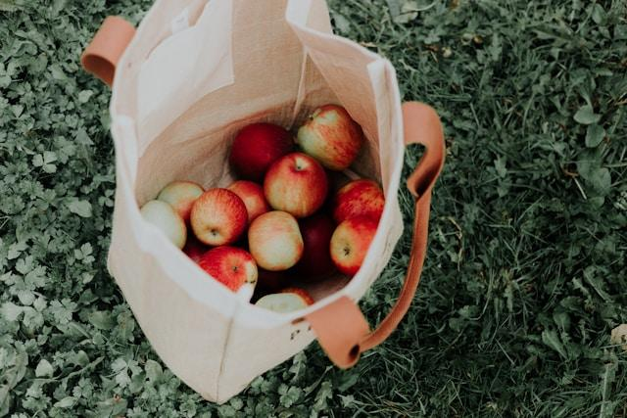
Examples from Previous Hack the Globe Winners
https://globalspark.world/hacktheglobe
EcoTrack (2024 – 1st Place)
BagSHARE (2023 – 1st Place)
Smart composters that reduce food waste while tracking disposal behaviour to improve sustainability practices.
A reusable bag-sharing system allowing consumers to borrow bags through a client app.

